Slide 1
Model of Static Density: Comparisons with Data
KCJ

Slide 2
Approach
Use Herron and Langway semi empirical model
Inputs are mean annual temperature and average accumulation rate
Requires selection of a surface density that is in fact a fitted parameter (I just chose one that seemed to work reasonably well)
Improvements to follow and include: Temperature variation with depth, seasonal forcings.

Slide 3
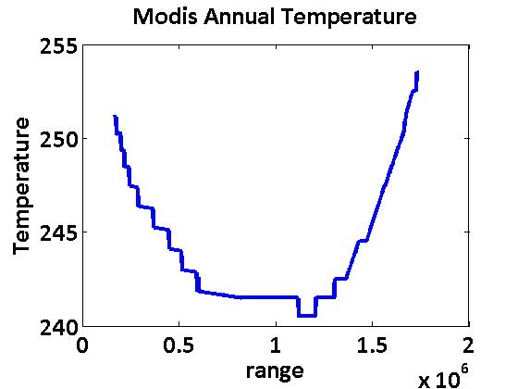
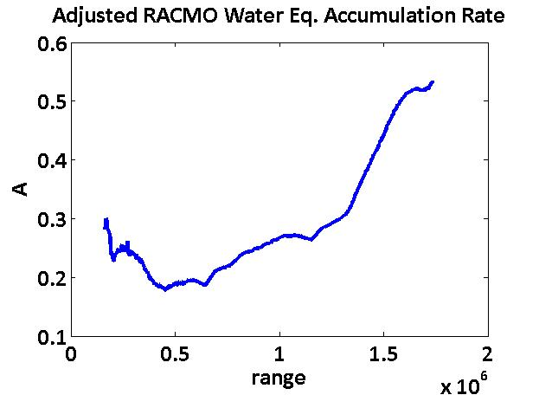
Model Inputs Taken along Interior Flight Line
ρ0 set equal to 0.32

Slide 4
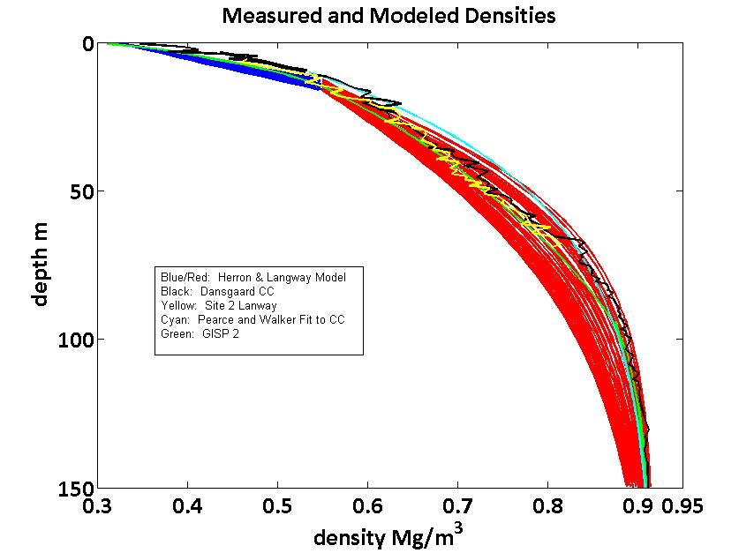
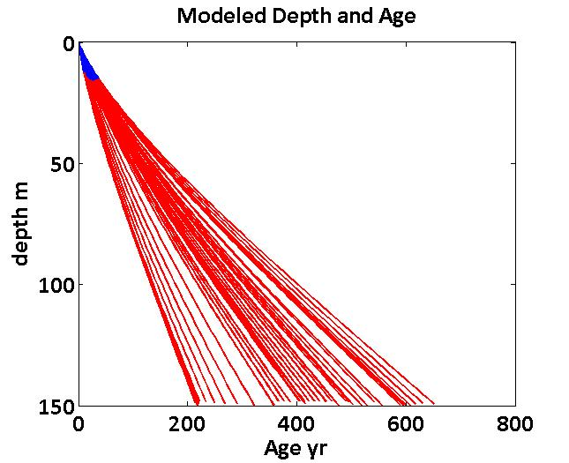
Measured and Modeled Densities and Ages along Flight Line (1000 range point interval)

Slide 5
Conclusions
Herron Langway model produces reasonable density profiles away from coast and using KCJ adjusted temperature and accumulation.
Near surface average densities change < 5% along profile.
Deeper densities vary by 10% or more but this is also the region where scattering becomes neglible.
For UWBRAD, we can probably use a single, mean-density curve for scattering corrections and modeling layer stratigraphy..
Adding a seasonal forcing may help define the parameters for the statistical model of layering.

